Slide 1
EXCEPTION HANDLING

Slide 2
Introduction
Users have high expectations for the code we produce.
Users will use our programs in unexpected ways.
Due to design errors or coding errors, our programs may fail in unexpected ways during execution
Exception Handling in Java

Slide 3
Introduction
It is our responsibility to produce quality code that does not fail unexpectedly.
Consequently, we must design error handling into our programs.
Exception Handling in Java

Slide 4
Advantage of Exception Handling
The core advantage of exception handling is that normal flow of the application is maintained.
Exception normally disrupts the normal flow of the application that is why we use exception
handling. Let's take a scenario:
statement 1;
statement 2;
statement 3;
statement 4;
statement 5; //Exception occurs here
statement 6;
statement 7;
statement 8;
statement 9;
statement 10;
Suppose there is 10 statements in your program and there occurs an exception at statement 5, rest
of the code will not be executed i.e. statement 6 to 10 will not run. If we perform exception
handling, rest of the statements will be executed. That is why we use exception handling.

Slide 5
Errors and Error Handling
Some typical causes of errors:
  Memory errors (i.e. memory incorrectly allocated, memory leaks, “null pointer”)
  File system errors (i.e. disk is full, disk has been removed)
  Network errors (i.e. network is down, URL does not exist)
  Calculation errors (i.e. divide by 0)
Exception Handling in Java

Slide 6
Types of errors
Compile-time errors
Run-time errors

Slide 7
Example
class Error
{
public static void main(String args [])
{
System.out.println(“Hello java”)
}
}

Slide 8
Syntax errors
Missing semicolons
Missing (or mismatch of) brackets in classes and methods
Misspelling of identifiers and keywords
Missing double quotes in strings
Use of undeclared variables
Incompatible types in assignments/initialization

Slide 9
Run-time errors
Dividing an integer by 0
Accessing an element that is out of bounds of an array
Trying to illegally change the state of a thread
Trying to store a value into an array of an incompatible class or type

Slide 10
Example
Class Errorr
{
public static void main(String args[])
{
int a=10, b=5, c=5;
int x=a/(b-c);
System.out.println(“x= ” +x);
int y=a/(b+c);
System.out.println(“y= ” +y);
}
}
Java.lang.ArithmeticException: / by zero

Slide 11
Exception
An exception is a condition that is caused by a
run-time error in the program

Slide 12
Exceptions
  Exceptions fall into three(3) categories:
    Checked Exceptions
    Unchecked Exceptions
    Error
  Checked exceptions are inherited from the core Java class Exception. They represent exceptions that are frequently considered “non fatal” to program execution e.g. IOException, SQLException etc. Checked exceptions are checked at compile-time
  Checked exceptions must be handled in your code, or passed to parent classes for handling.
June 14, 2001
Manav Rachna College of Engg.

Slide 13
Exceptions
  Unchecked exceptions represent error conditions that are considered “fatal”
  to program execution e.g.
  ArithmeticException,
  NullPointerException,
  ArrayIndexOutOfBoundsException etc.
  Unchecked exceptions are not checked at compile-time
  rather they are checked at runtime.
Error
Error is irrecoverable e.g. OutOfMemoryError, VirtualMachineError,
AssertionError etc.
Manav Rachna College of Engg.

Slide 14
Common scenarios of Exception Handling where exceptions may occur
There are given some scenarios where unchecked exceptions can occur. They are as follows
1) Scenario where ArithmeticException occurs
If we divide any number by zero, there occurs an ArithmeticException.
int a=50/0;//ArithmeticException
2) Scenario where NullPointerException occurs
If we have null value in any variable, performing any operation by the variable
occurs an NullPointerException.
String s=null;
System.out.println(s.length()); //NullPointerException

Slide 15
3) Scenario where NumberFormatException occurs
The wrong formatting of any value, may occur NumberFormatException. Suppose I have a string variable that have characters, converting this variable into digit will occur NumberFormatException.
String s="abc";
int i=Integer.parseInt(s); //NumberFormatException
4) Scenario where ArrayIndexOutOfBoundsException occurs
If you are inserting any value in the wrong index, it would result ArrayIndexOutOfBoundsException as shown below:
int a[]=new int[5];
a[10]=50; //ArrayIndexOutOfBoundsException

Slide 16
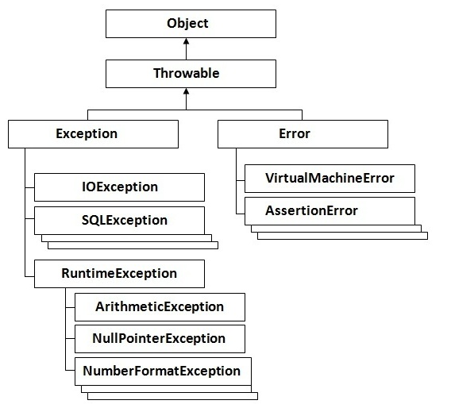
Hierarchy of Exception classes

Slide 17
Exception handling
Catching the exception object thrown by the error condition and then display an appropriate message for taking corrective actions is referred to as Exception handling

Slide 18
Error handling code , Mechanism…..
Find the problem (Hit the Exception)
Inform that an error has occurred (Throw the exception)
Receive the error information(Catch the exception)
Take corrective actions (Handle the execution)

Slide 19
Common Exceptions
Exception Type | Cause of Exception
ArithmeticException | Caused by math errors such as division by 0
ArrayIndexOutOfBoundsException | Caused by bad array indexes
ArrayStoreException | Caused when a program tries to store the wrong type of data in an array
FileNotFoundException | Caused by an attempt to access a non existent file
StringIndexOutofBoundsException | Caused when a program attempts to access a non existent character position in a string
OutOfMemoryException | Caused when there is not enough memory to allocate a new object
IOException | Caused by general I/o failures, such as inability to read from a file

Slide 20
Syntax of exception handling code
Try Block
Exception object creator
Statement that causes an exception
Throws Exception
object
Catch Block
Exception handler
Statement that handles the exception
Exception handling mechanism

Slide 21
Use of (try-catch)
………….
………….
try
{
statement; // generates an exception
}
catch(Exception-type e)
{
statement; // processes the exception
}
………….
………….

Slide 22
Problem without exception handling
class Simple
{
public static void main(String args[])
{
int data=50/0;
System.out.println("rest of the code...");
}
}
Output: Exception in thread main java.lang.ArithmeticException:/ by zero

Slide 23
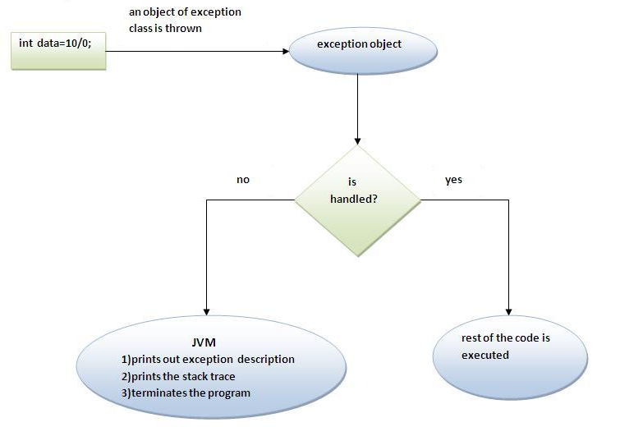
What happens behind the code

Slide 24
Class Error2
{
public static void main(String args[])
{
int a=10;
int b=5;
int c=5;
int x,y;
try
{
x=a/(b-c); // Exception here
}
catch(ArithmeticException e)
{
System.out.println(“ Division by zero”);
}
y= a/ (b+c);
System.out.println(“y=“ +y);
}
}
Example

Slide 25
Multiple catch statements
If you have to perform different tasks at the occurrence of different Exceptions, use multiple catch block.
………….
………….
try
{
statement; // generates an exception
}
catch(Exception-type -1 e)
{
statement; // processes exception type 1
}
catch(Exception-type -2 e)
{
statement; // processes exception type 2
}
.
.
.
catch(Exception-type -N e)
{
statement; // processes exception type N
}
………….
………….

Slide 26
Using multiple catch blocks
Class Error
{
psvm(String args[])
{
int a[]={5,10};
int b =5;
try
{
int x=a[2]/b-a[1];
}
catch(ArithmeticException e)
{
S.o.p(“division by 0”);
}
catch(ArrayIndexOutofBoundsException e)
{
S.o.p(“ Array index error”);
}
catch(ArrayStoreException e)
{
S.o.p(“ wrong data type”);
}
int y= a[1]/a[0];
System.out.println(“y=“ +y);
}
}
Note1: At a time only one Exception is occurred and at a time only one catch block is executed.
Note2: All catch blocks must be ordered from most specific to most general i.e. catch for ArithmeticException must come before catch for Exception .

Slide 27
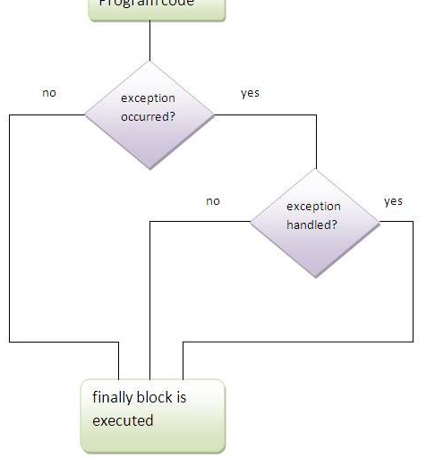
finally block
The finally block is a block that is always executed. It is mainly used to perform some important tasks such as closing connection, stream etc.
Note:Before terminating the program, JVM executes finally block(if any).
Note:finally must be followed by try or catch block.

Slide 28
Why use finally block?
finally block can be used to put "cleanup" code such as closing a file,closing connection etc.
Rule: For each try block there can be zero or more catch blocks, but only one finally block.
Note: The finally block will not be executed if program exits(either by calling System.exit() or by causing a fatal error that causes the process to abort).

Slide 29
Using finally statement
try
{
………….
………….
}
finally
{
………….
………….
}

Slide 30
try
{
………….
………….
}
catch(……….)
{
………….
………….
}
catch(……….)
{
………….
………….
}
.
.
finally
{
………….
………….
}

Slide 31
throw keyword
The throw keyword is used to explicitly throw an exception. We can throw either checked or unchecked exception. The throw keyword is mainly use to throw custom exception.
class Excep13
{
static void validate(int age)
{
if(age<18)
throw new ArithmeticException("not valid");
else
System.out.println("welcome to vote");
}
public static void main(String args[]) {
validate(13);
System.out.println("rest of the code...");
} }

Slide 32
Exception propagation
An exception is first thrown from the top of the stack and if it is not caught, it drops down the call stack to the previous method, If not caught there, the exception again drops down to the previous method, and so on until they are caught or until they reach the very bottom of the call stack. This is called exception propagation.

Slide 33
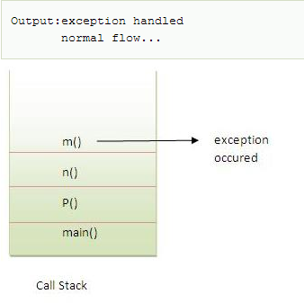
Rule: By default Unchecked Exceptions are forwarded in calling chain (propagated).
class Simple{
void m(){
int data=50/0;
}
void n(){
m();
}
void p(){
try{
n();
}catch(Exception e){System.out.println("exception handled");}
}
public static void main(String args[]){
Simple obj=new Simple();
obj.p();
System.out.println("normal flow...");
}
}

Slide 34
Rule: By default, Checked Exceptions are not forwarded in calling chain (propagated).
class Simple{
void m(){
throw new java.io.IOException("device error");//checked exception
}
void n(){
m();
}
void p(){
try{
n();
}catch(Exception e){System.out.println("exception handeled");}
}
public static void main(String args[]){
Simple obj=new Simple();
obj.p();
System.out.println("normal flow");
}
}

Slide 35
throws keyword
The throws keyword is used to declare an exception. It gives an information
to the programmer that there may occur an exception so it is better for the
programmer to provide the exception handling code so that normal flow can
be maintained.
Exception Handling is mainly used to handle the checked exceptions. If there
occurs any unchecked exception such as NullPointerException, it is
programmers fault that he is not performing check up before the code being
used.
Syntax of throws keyword:
void method_name() throws exception_class_name
{
...
}

Slide 36
Program which describes that checked exceptions can be propagated by throws keyword.
import java.io.IOException;
class Simple{
void m()throws IOException{
throw new IOException("device error");//checked exception
}
void n()throws IOException{
m();
}
void p(){
try{
n();
}catch(Exception e){System.out.println("exception handled");}
}
public static void main(String args[]){
Simple obj=new Simple();
obj.p();
System.out.println("normal flow...");
}
}

Slide 37
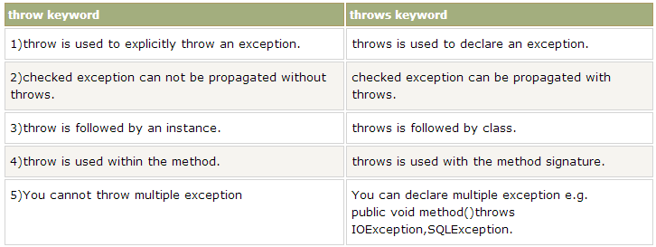
Difference between throw and throws:

Slide 38
Throwing our own Exceptions
throw new Throwable_subclass;
Example:
throw new ArithmeticException();
throw new NumberFormatException();

Slide 39
import java.io.*;
class UserException extends Exception
{
UserException (int a, int b)
{
System.out.println("UserException Caught: The sum of the numbers Exceeds 20.”);
}
}
class calculate
{
void calculate(int a, int b) throws UserException
{
int sum;
sum=a+b;
if(sum>20)
throw new UserException (a,b);
System.out.println("The value of the sum of the two numbers is: "+sum);
}
}

Slide 40
class UserExceptionDemo
{
public static void main(String args[]) throws UserException
{
calculate c=new calculate();
int num1, num2;
Scanner s=new Scanner(System.in);
System.out.println("Enter two numbers to be added: ");
num1=s.nextInt();
num2=s.nextInt();
try
{
c.calculate(num1,num2);
}
catch(UserException ue)
{
System.out.println(“Exception has been caught”);
}
}
}

